Slide 1
Tesla Stock Price Forecasting
Team Members:
Siddharth Paraag Nilakhe
Preeti Reddy Koppolu

Slide 2
Brief Overview
Our aim is to forecast Tesla’s stock price for the next 30 trading sessions using Deep learning techniques.
Our main focus will be on implementing and evaluating Recurrent Neural Networks (RNNs), particularly Long Short-Term Memory (LSTM) networks and Gated Recurrent Units (GRU), due to their effectiveness in handling time series data.
The motivation behind this approach stems from the capabilities of these models to capture temporal dependencies and patterns in time-series data, which is critical for accurate stock price forecasting.
The approach involves preprocessing historical stock price data, applying data normalization, and creating a time-stepped dataset to train the deep learning models.

Slide 3
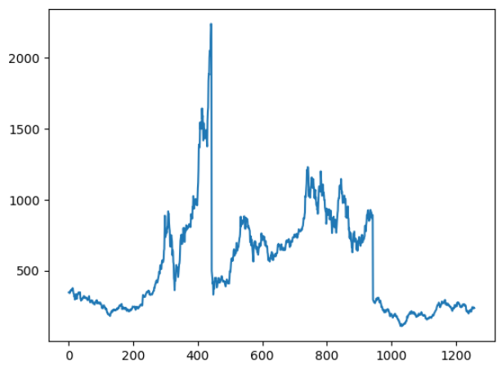
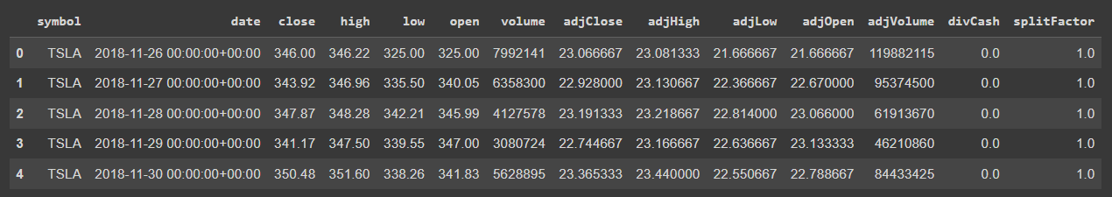
Dataset
We have collected the data from TIINGO through get API Call.
We have collected data for the last 5 years and will be used for our forecasting purposes.

Slide 4
Tools and Technologies
Pandas Datareader
Pandas
Numpy
Matplotlib
Scikit-learn
TensorFlow
Keras
Google Colab

Slide 5
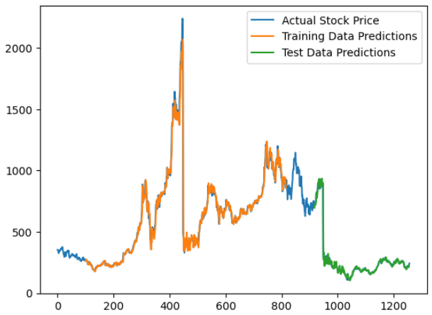
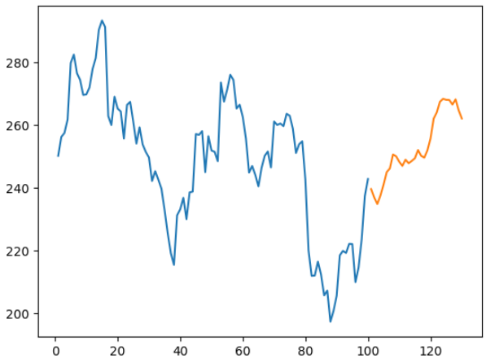
Recurrent Neural Network
The model consists of a SimpleRNN layer with 50 neurons followed by a Dense layer.
The input shape is set according to the time steps (100 days).
The model is compiled using the Adam optimizer and mean squared error loss function.
Train Mean Squared Error : 743.75
Test Mean Squared Error: 334.34

Slide 6
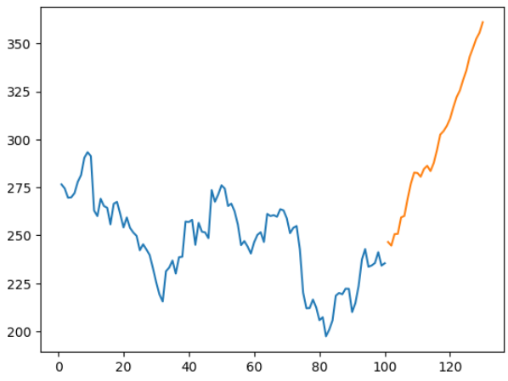
Stacked Recurrent Neural Network
The model consists of three SimpleRNN layers with 50 neurons followed by a Dense layer.
The input shape is set according to the time steps (100 days).
The model is compiled using the Adam optimizer and mean squared error loss function.
Train Mean Squared Error : 748.43
Test Mean Squared Error: 325.80

Slide 7
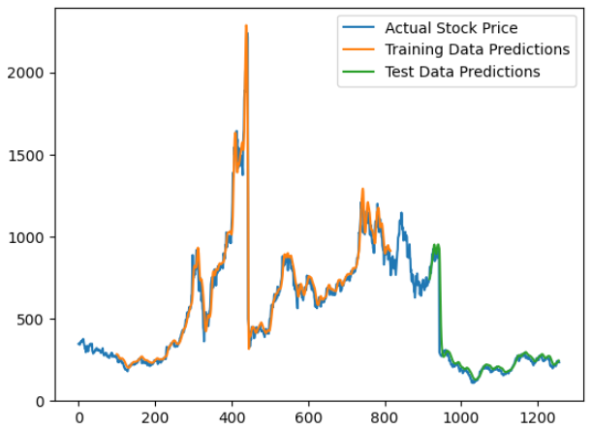
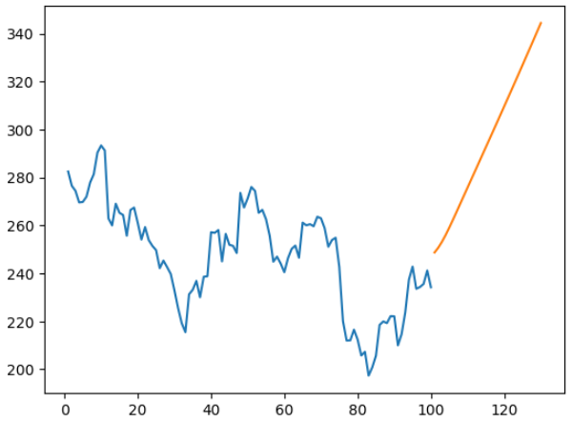
Long Short-Term Memory
The model consists of three LSTM layers with 50 neurons followed by a Dense layer.
The input shape is set according to the time steps (100 days).
The model is compiled using the Adam optimizer and mean squared error loss function.
Train Mean Squared Error : 764.48
Test Mean Squared Error: 341.67

Slide 8
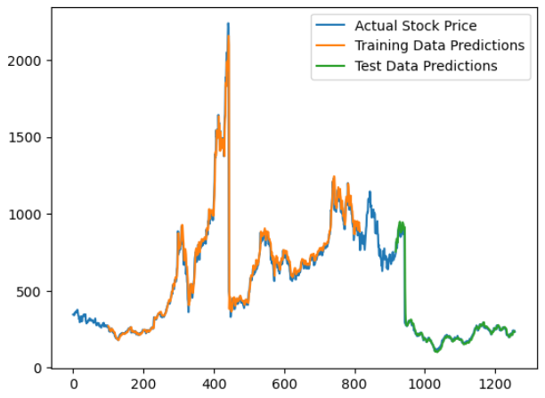
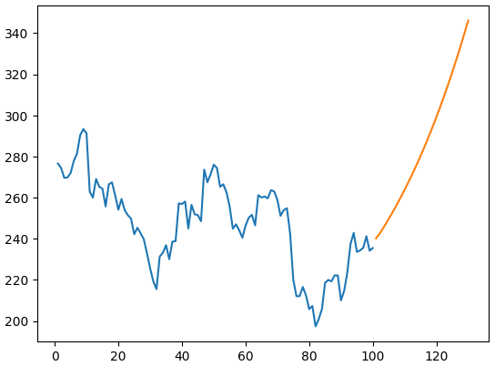
Gated Recurrent Unit (GRU)
The model consists of three GRU layer with 50 neurons followed by a Dense layer.
The input shape is set according to the time steps (100 days).
The model is compiled using the Adam optimizer and mean squared error loss function.
Train Mean Squared Error : 751.85
Test Mean Squared Error: 327.99

Slide 9
Optimization Method - Hyper Parameter Tuning Technique
Defined an model with variable hyperparameters such as units, batch size, optimizer and number of epoch’s.
RandomizedSearchCV is employed with KerasRegressor model for tuning, running a specified number of iterations (n_iter) across different hyperparameter combinations to determine the most effective model settings based on the training data.
'units': [20, 50, 100]
'optimizer': ['adam', 'rmsprop']
'batch_size': [16, 32, 64]
'epochs': [ 50, 100, 150]

Slide 10
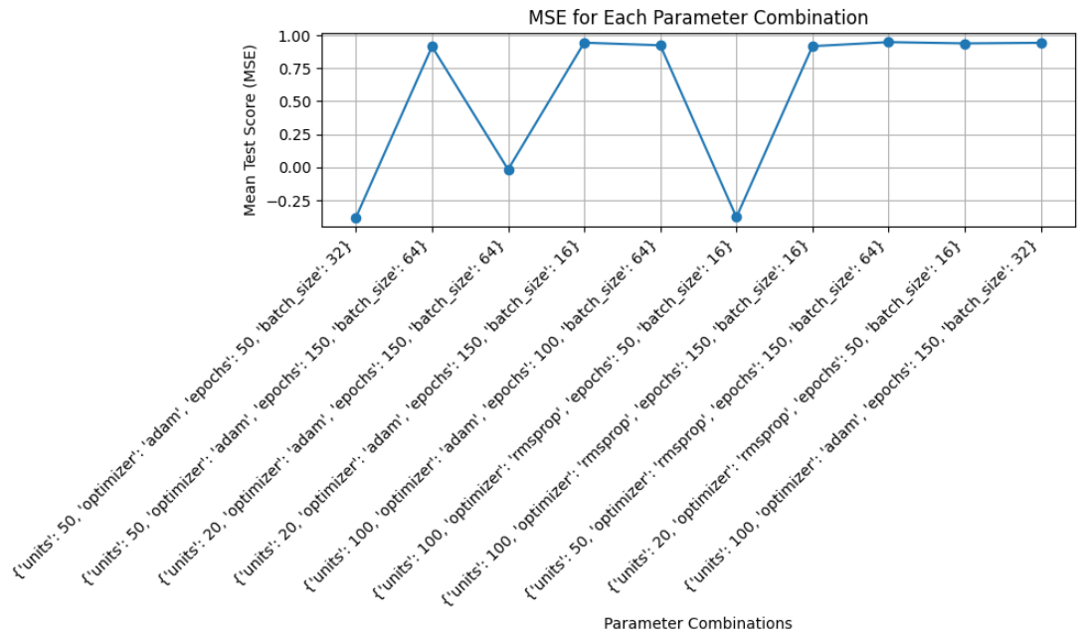
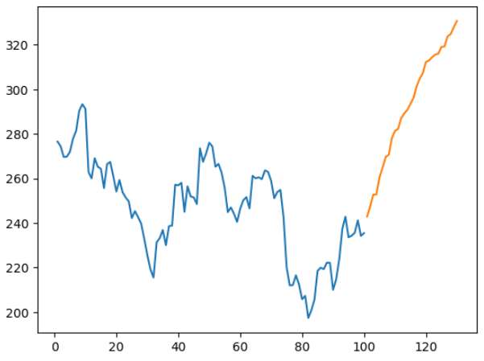
Hyper parameter Tuning - Recurrent Neural Network
Best: 0.947625 using {'units': 50, 'optimizer': 'rmsprop', 'epochs': 150, 'batch_size': 64}
Train Mean Squared Error : 751.47 Test Mean Squared Error: 328.38

Slide 11
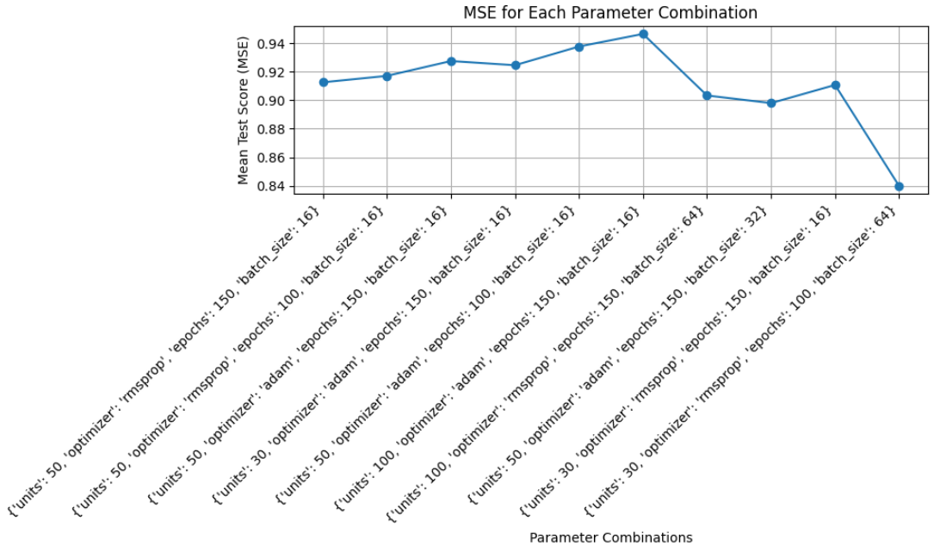
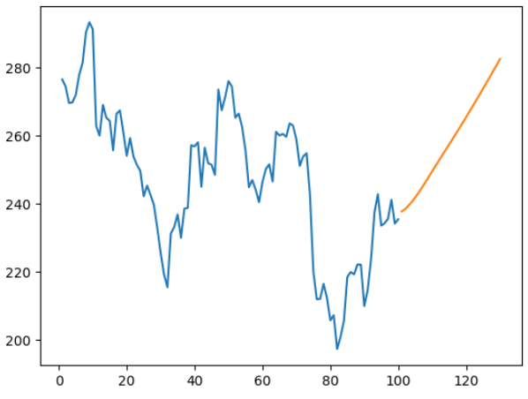
Hyper parameter Tuning - Long Short-Term Memory
Best: 0.946569 using {'units': 100, 'optimizer': 'adam', 'epochs': 150, 'batch_size': 16}
Train Mean Squared Error : 762.35 Test Mean Squared Error: 327.32

Slide 12
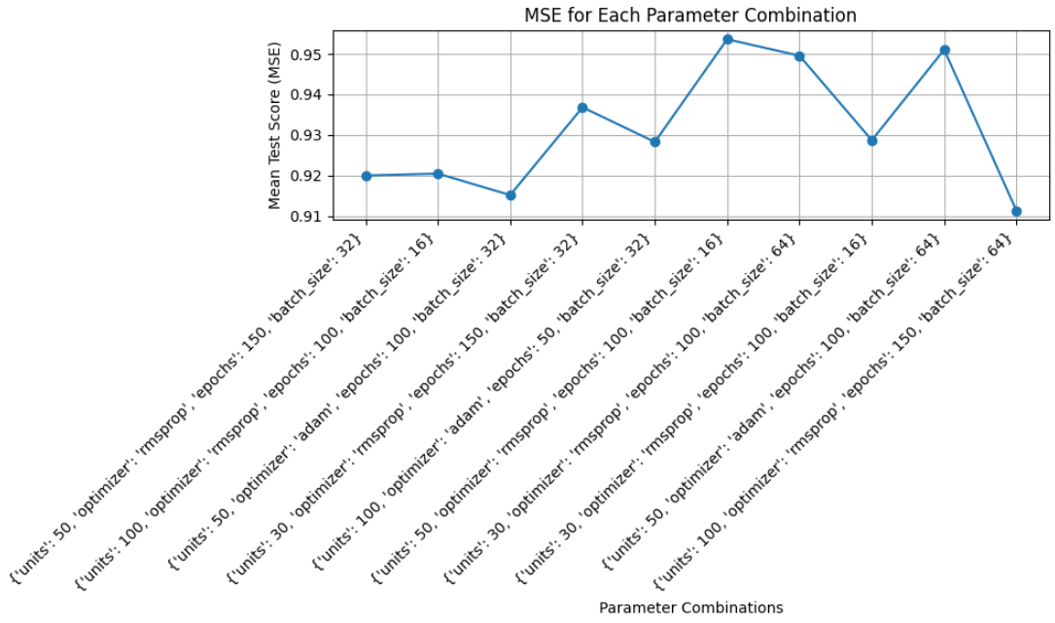
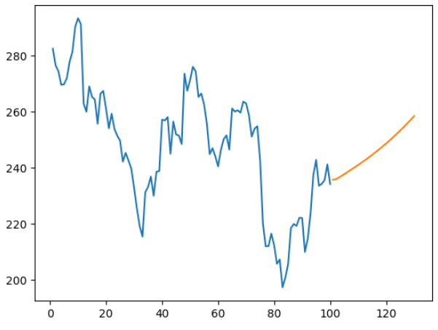
Hyper parameter Tuning - Gated Recurrent Unit (GRU)
Best: 0.953608 using {'units': 50, 'optimizer': 'rmsprop', 'epochs': 100, 'batch_size': 16}
Train Mean Squared Error : 747.56 Test Mean Squared Error: 323.67

Slide 13
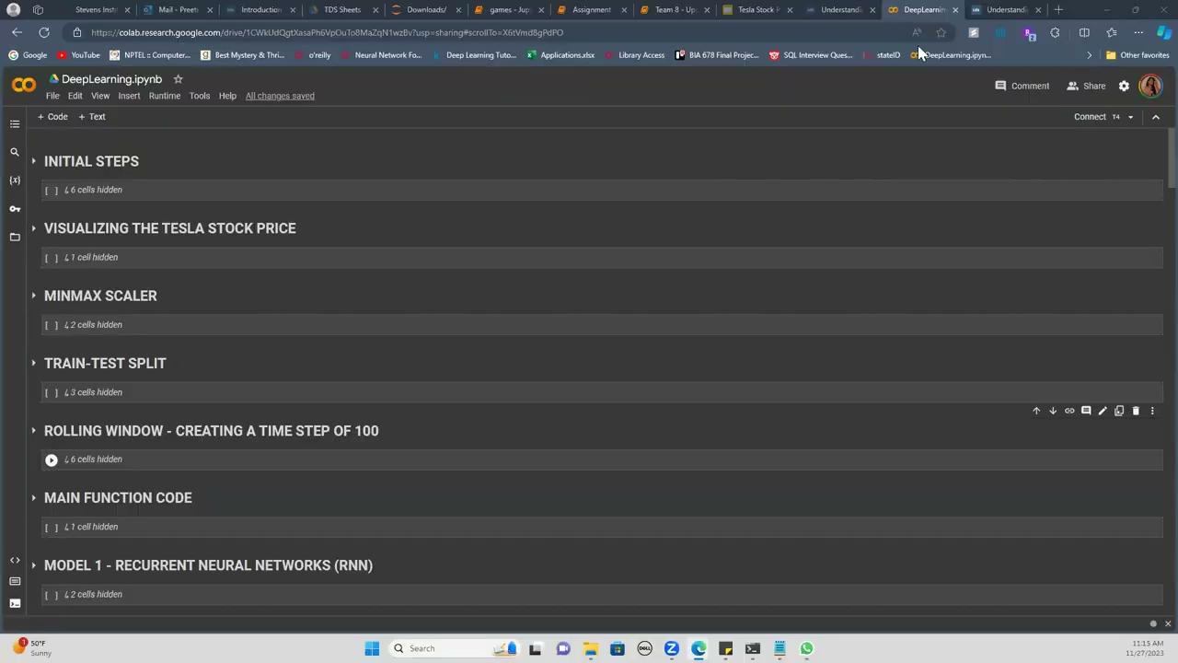
Demo Video of Project

Slide 14
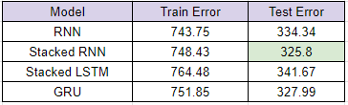

Conclusion
The project's findings highlight the significance of machine learning in financial analysis, offering a promising tool for investors and analysts.
The models, optimized through hyperparameter tuning, showcased varying degrees of efficacy in handling the complexities of time-series data.
Gated Recurrent Unit model proved to be the best model with lowest test mean squared error in price forecasting.

Slide 15
THANK YOU
Team Members:
Siddharth Paraag Nilakhe
Preeti Reddy Koppolu

